Slide 2
ROOT LOCUS
03.03.25

Slide 3




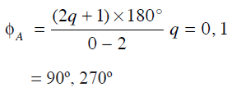

Problems in Root Locus
PROBLEM No. 1

Slide 4
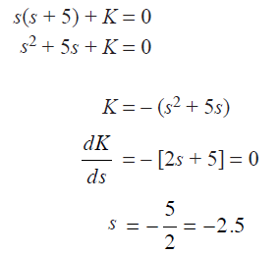
Problems in Root Locus

Slide 5
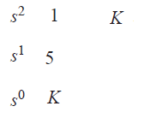



Problems in Root Locus

Slide 6
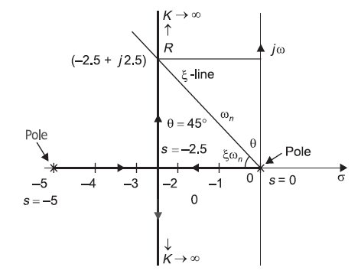
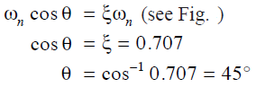
Problems in Root Locus

Slide 8





PROBLEMS FOR PRACTICE IN ROOT LOCUS
PROBLEM No. 2

Slide 9

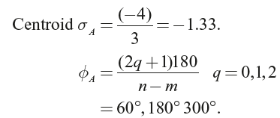
Problems in Root Locus

Slide 10

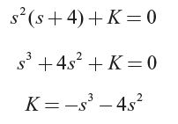
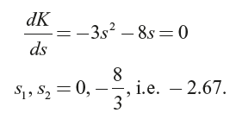
Problems in Root Locus

Slide 11


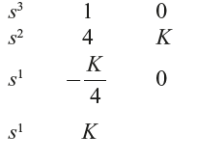
Problems in Root Locus

Slide 12
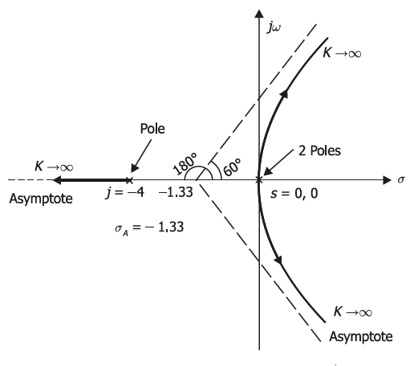
Problems in Root Locus

Slide 13




Problems in Root Locus
PROBLEM No. 3

Slide 14
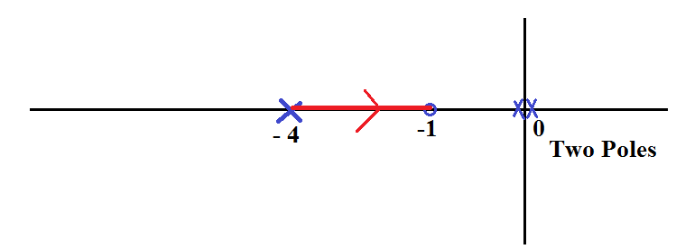


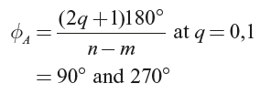
Problems in Root Locus

Slide 15

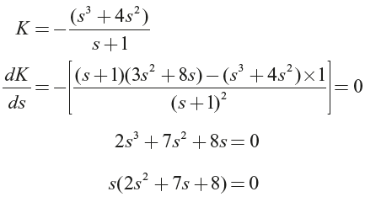

Problems in Root Locus

Slide 16


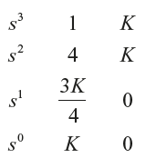
Problems in Root Locus

Slide 17
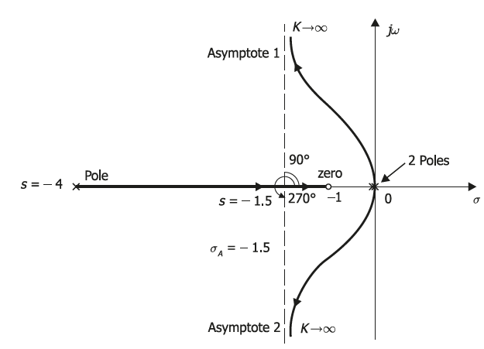
Problems in Root Locus

Slide 18




Problems in Root Locus
PROBLEM No. 4

Slide 19
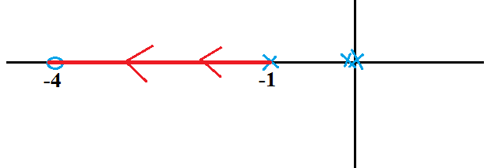

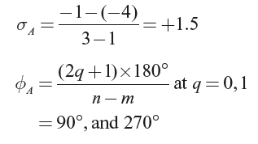
Problems in Root Locus

Slide 20

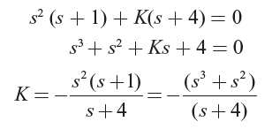
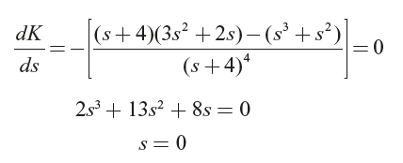
Problems in Root Locus

Slide 21

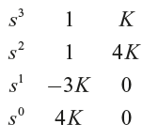
Problems in Root Locus

Slide 22
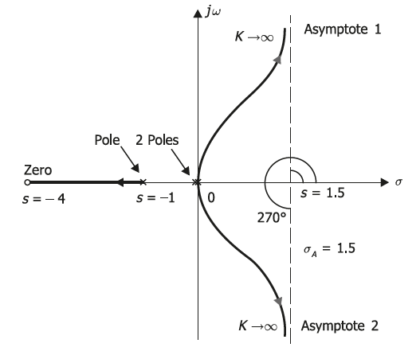
Problems in Root Locus

